Slide 1
MitoImpute: Mitochondrial DNA reference panel and imputation pipeline
Tim W McInerney, Brian Fulton-Howard, Christopher Patterson, Devashi Paliwal, Lars S Jermiin, Hardip R Patel, Judy Pa, Russell H Swerdlow, Alison Goate, Simon Easteal, Shea J Andrews, for the Alzheimer’s Disease Neuroimaging Initiative

Slide 2
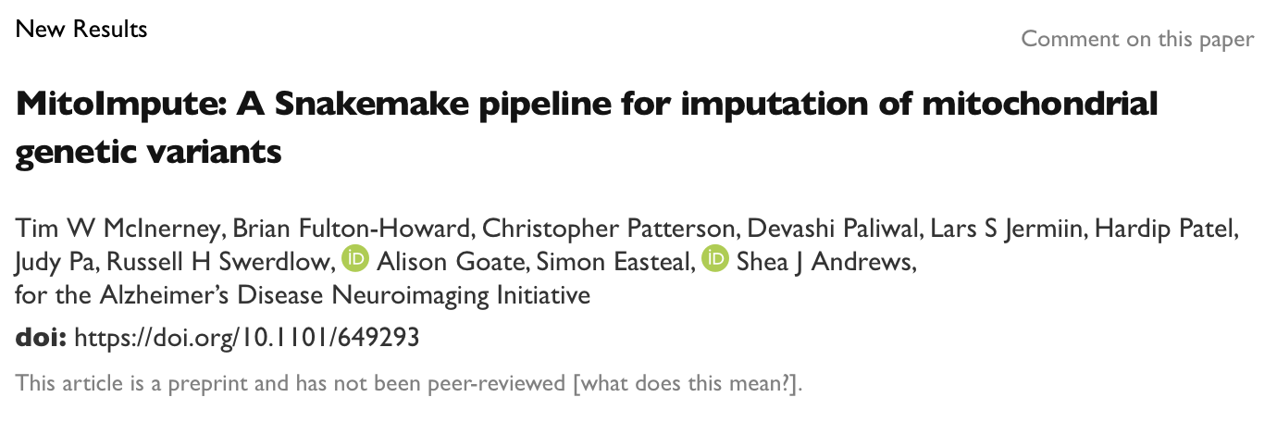

Slide 3
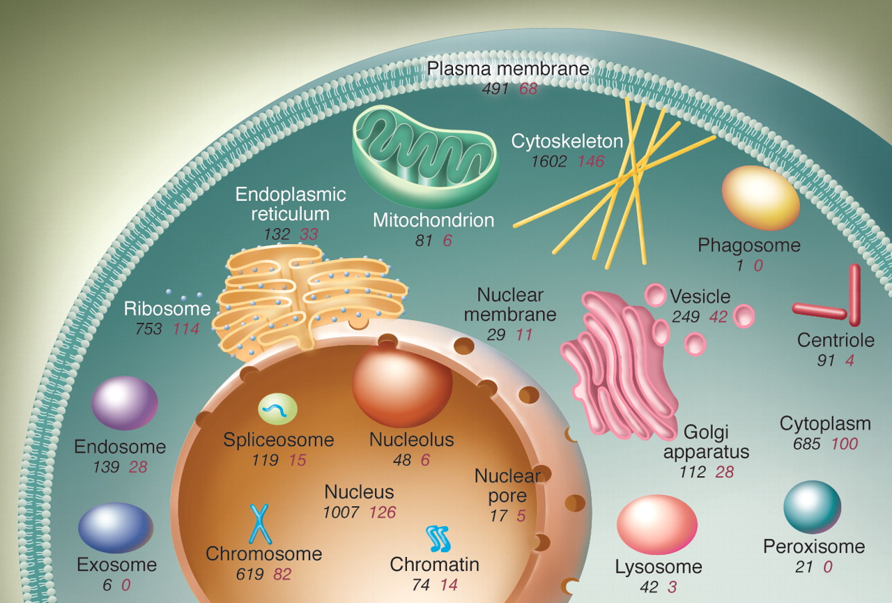
Mitochondrial DNA (mtDNA)
Genome of mitochondrion organelles found within cytosol of eukaryotic organisms
Genome separate from nuclear genome
Some mitochondrial genes are encoded in nuclear genome
Kurland, et al. (2006) Genomics and the irreducible nature of eukaryote cells. Science 312(5776): 1011-1014.
Notes:
The mitochondria is an organelle that sits within the cytosol of eukaryotic cells, but outside of the nucleus and separate to the autosomes and sex chromosomes

Slide 4
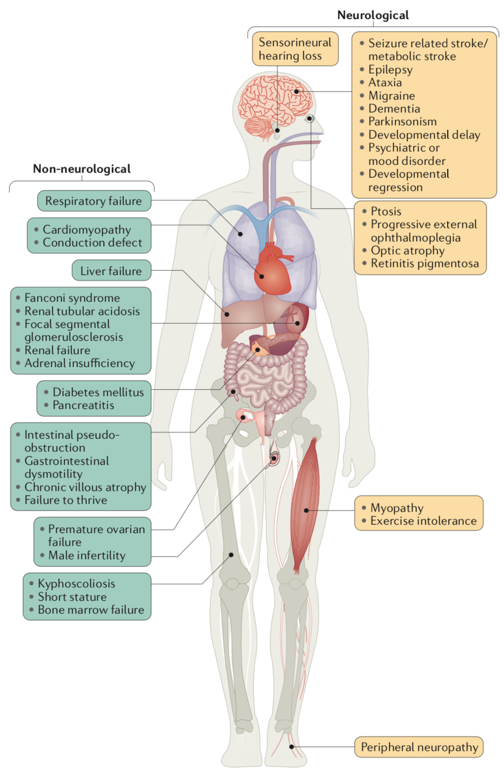
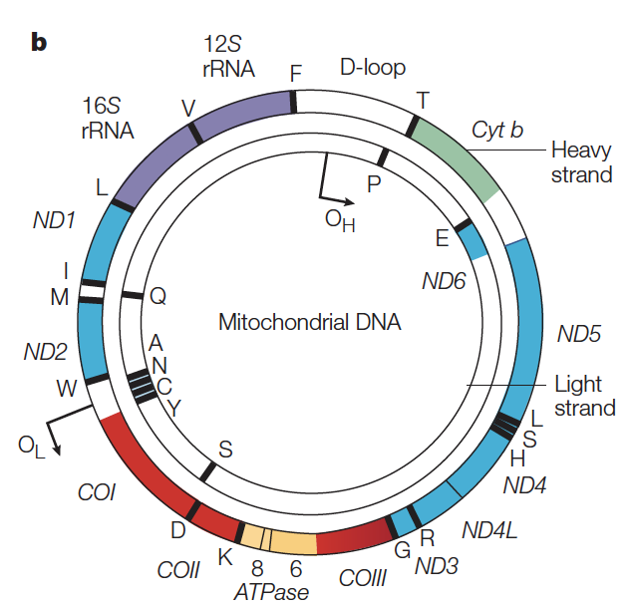
Mitochondrial DNA (mtDNA) and human disease
Taylor and Turnbull (2005) Mitochondrial DNA mutations in human disease. Nature Reviews Genetics 6(5): 389-402
Gorman, et al. (2016) Mitochondrial diseases. Nature Reviews Disease Primers 2: 16080
Notes:
The mitochondria is an organelle that sits within the cells, but outside of the nucleus and separate to the autosomes and sex chromosomes
Multiple mitochondria per cell
Mitochondria have a separate genome
16,569 nucleotides long in humans
37 genes
13 genes coding for the oxidative phosphorylation system (energy from food → ATP)
22 tRNA (transport RNA) genes
2 rRNA (ribosomal RNA) genes
Therefore mutations in mtDNA are often causes defects in oxidative phosphorylation, leading to serious diseases

Slide 5
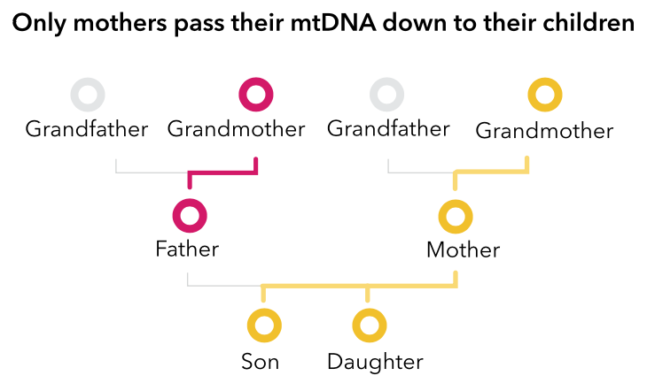
Mitochondrial DNA (mtDNA)
23andMe
Notes:
MtDNA is almost exclusively maternally inherited in humans
MtDNA is assumed to be non-recombining
Due to high copy number, mtDNA is easy to sequence
Due to relatively fast mutation rate, it accumulates phylogenetic signal rapidly

Slide 6
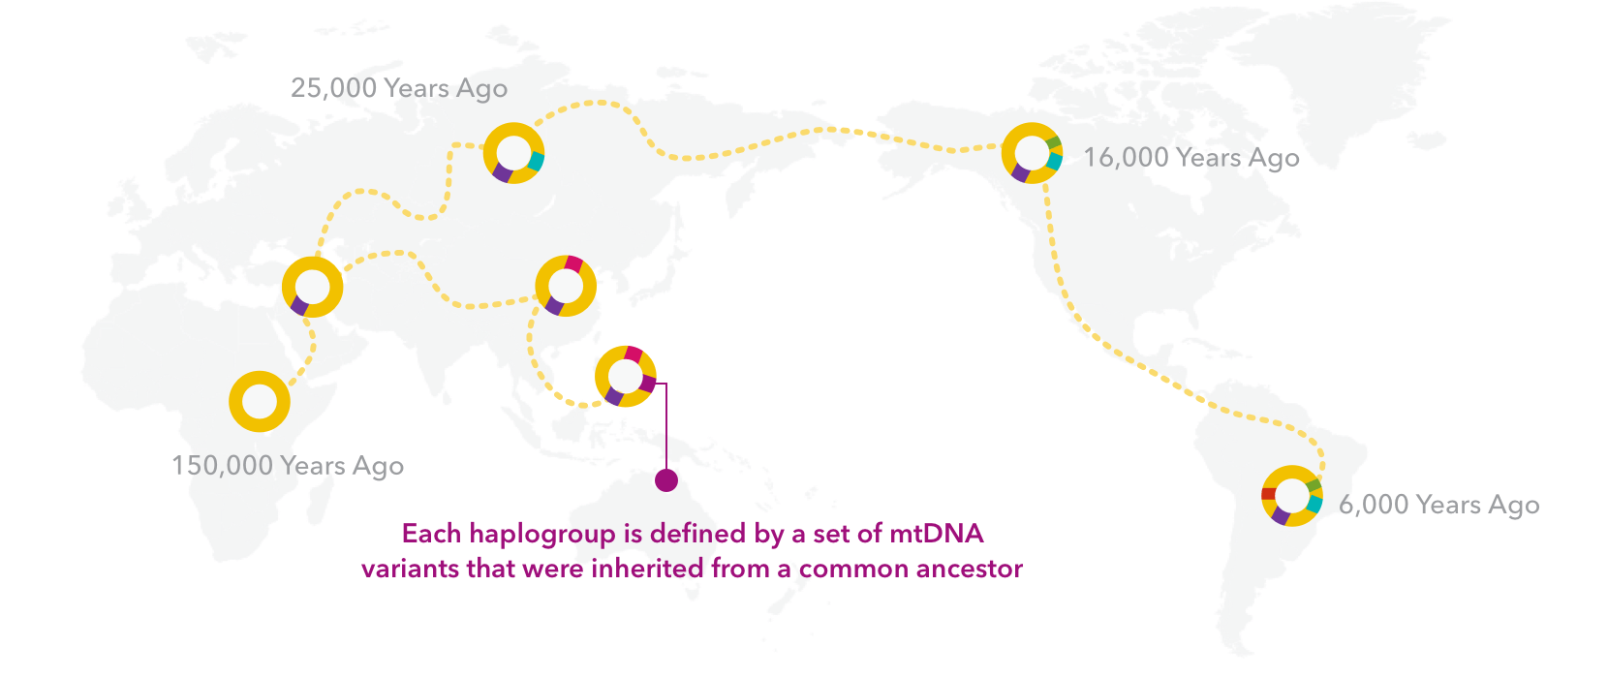
mtDNA is used to track evolutionary history
23andMe
Notes:
This has made it incredibly useful for understanding human evolution, including how people moved out of Africa and colonised the world
Individuals that have an identical mtDNA sequence are said to share a haplotype.
Haplotypes that share a common ancestor to the exclusion of all others form a haplogroup
Haplogroups are defined by mutations at specific sites according to the PhyloTree nomenclature and the revised Cambridge Reference Sequence numbering system

Slide 7
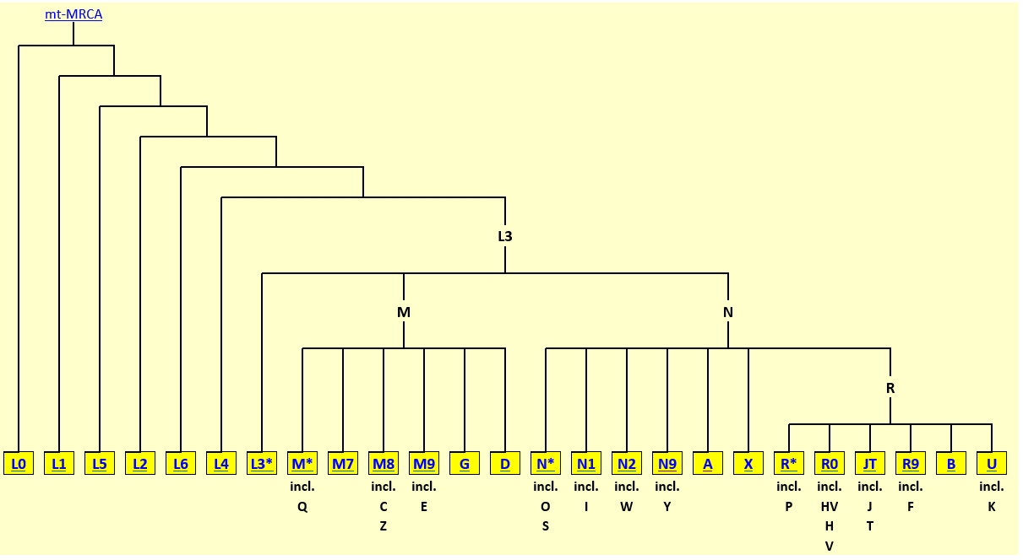
mtDNA Haplogroups
PhyloTree, van Oven (2017)

Slide 8
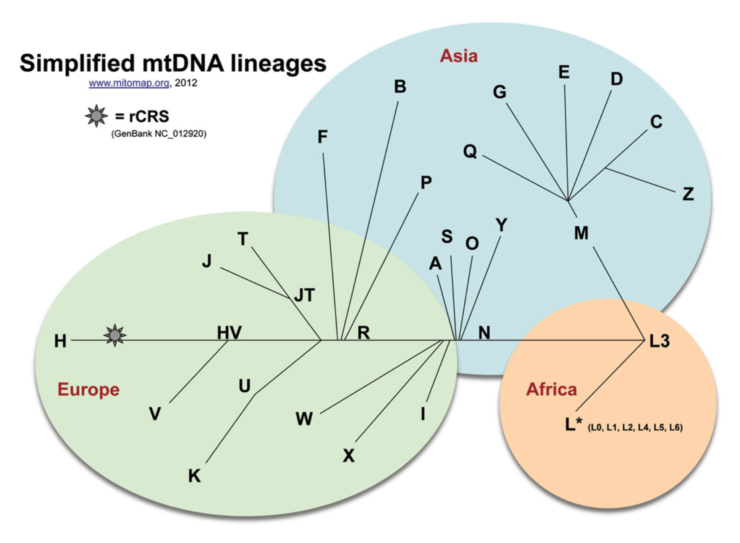
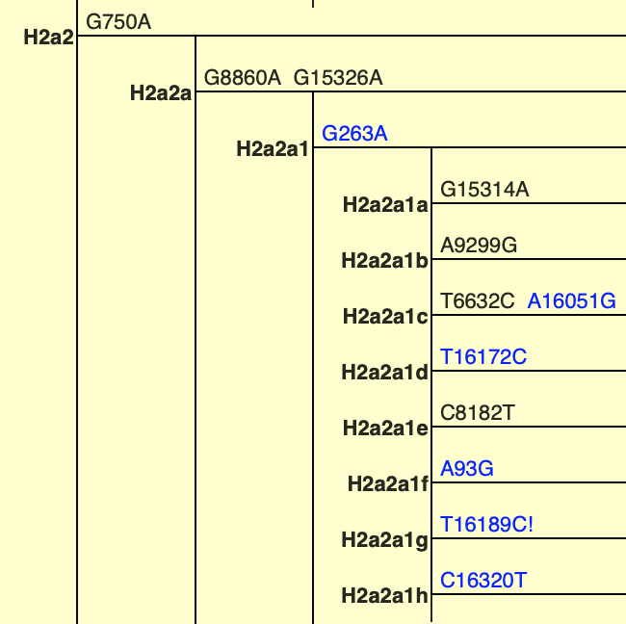
mtDNA haplogroups are a proxy for phylogenetic placement
H2a2a1
G → A mutation at position 8860 and 15326 defines haplogroup H2a2a1
van Oven (2015) PhyloTree Build 17: Growing the human mitochondrial DNA tree. Forensic Science International: Genetics Supplement Series 5: e392-e394
Notes:
Haplogroups are described by an alternating alphanumeric nomenclature
Major lineages (also known as macro-haplogroups) are denoted by a capitalised letter
Sub-lineages are then denoted by a number, followed by a lower case number
Haplogroups are defined by collections of mutations across the mtDNA
Haplogroups are then predicted by software that utilises genotypes at available sites

Slide 9
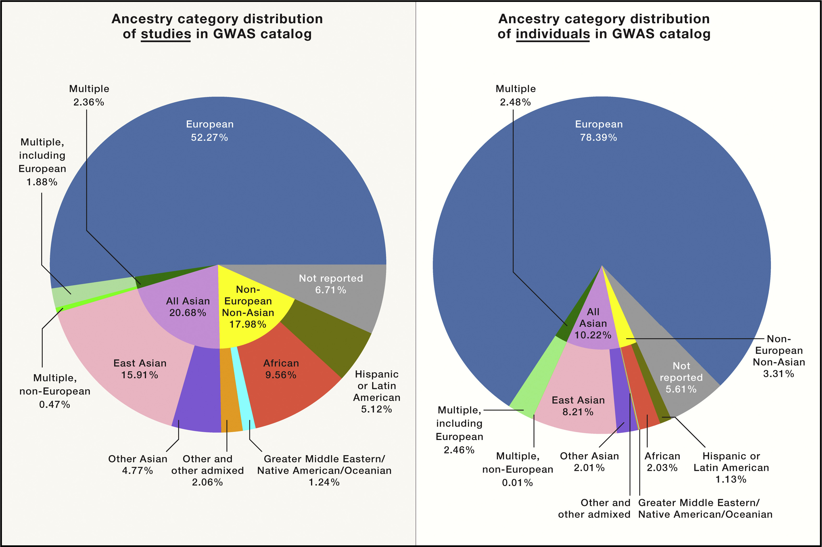
Sirugo, et al. (2019) The Missing Diversity in Human Genetic Studies. Cell 177(1): 26-31.

Slide 10
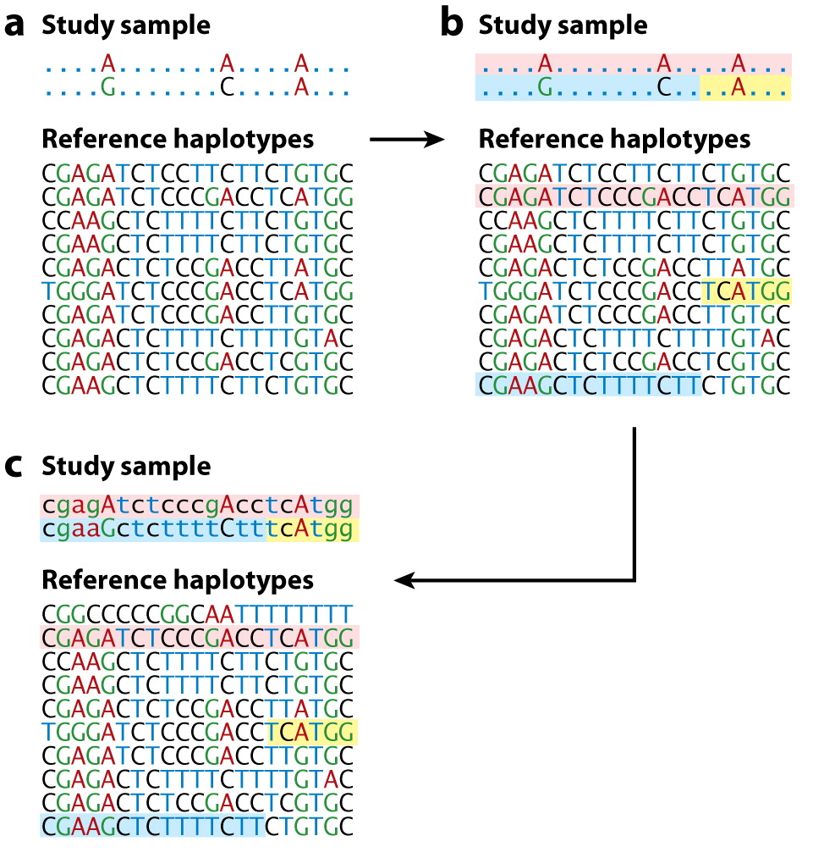
Basic imputation procedure:
Sample genotypes and reference haplotypes are gathered
Sample genotypes are matched to their closest haplotypes in the reference panel
Missing variant in filled in
Imputation of missing DNA variants relies on a reference panel that contains haplotypes representative of population genetic diversity
If a population isn’t represented in a reference, their haplotypes will be missed
Li, et al. (2009) Genotype imputation. Annual Review of Genomics and Human Genetics 10: 387-406.

Slide 11
Missing diversity and incomplete data
No publicly available mitochondrial reference panel exists that is:
Well-curated and high-quality
Globally representative
Genotyping studies only capture known points of variation or points of interest
Misses variants rare globally or private to under-represented populations
Not comparable to modern full-sequence data (i.e. ADNI 3)

Slide 12
MitoImpute reference alignment
Downloaded 44,299 publicly available complete human mitochondrial genome sequences
Aligned sequences to a reference alignment
Ensures the consistent placement of sequence ‘gaps’
>7k sequences aligned to the revised Cambridge Reference Sequence (rCRS)
Mixture of alignment by algorithm and manual decisions made by experienced researchers

Slide 13
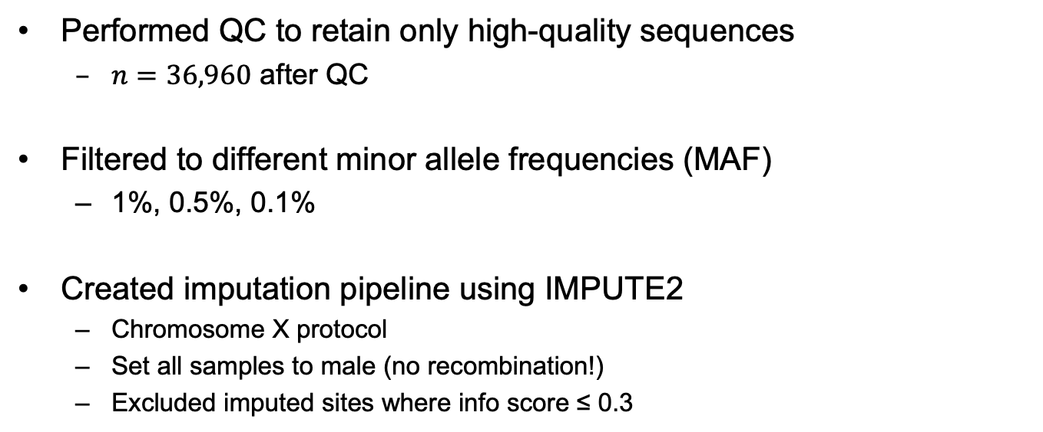
MitoImpute reference panel
Performed QC to retain only high-quality sequences
$n=36,960$ after QC
Filtered to different minor allele frequencies (MAF)
1%, 0.5%, 0.1%
Created imputation pipeline using IMPUTE2
Chromosome X protocol
Set all samples to male (no recombination!)
Excluded imputed sites where info score ≤ 0.3

Slide 14
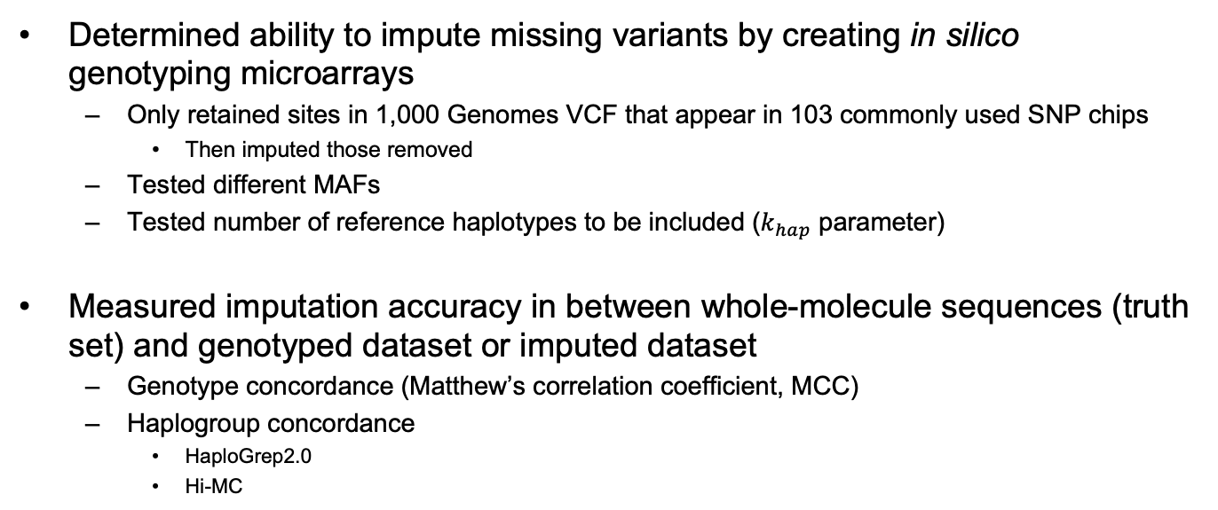
MitoImpute reference panel
Determined ability to impute missing variants by creating in silico genotyping microarrays
Only retained sites in 1,000 Genomes VCF that appear in 103 commonly used SNP chips
Then imputed those removed
Tested different MAFs
Tested number of reference haplotypes to be included ($k_{hap}$ parameter)
Measured imputation accuracy in between whole-molecule sequences (truth set) and genotyped dataset or imputed dataset
Genotype concordance (Matthew’s correlation coefficient, MCC)
Haplogroup concordance
HaploGrep2.0
Hi-MC

Slide 15
Alignment is high-quality
Feature | Value(s)
Sequences | 44,299
Sites | 16,569
Completeness Score (C_{a}) | 0.9997
C-score for individual sequences (C_{r}) [min-max] | 0.9119 - 1.0000
C-score for individual sites (C_{c}) [min-max] | 0.4429 - 1.0000
C-score for pairs of sequences (C_{ij}, i≠j) [min-max] | 0.8314 - 1.0000
Measured alignment quality in AliStat
C_{a} is the completeness of the alignment
C_{r} is the completeness of the r^{th} sequence
C_{c} is the completeness of the c^{th} site
C_{ij} is the completeness of the i^{th} and j^{th} sequences.

Slide 16
Reference alignment/panel is globally diverse
Country | Frequency | Percent of samples with geographic provenance information | Percent of total number of samples in filtered data (n=36,960) | Percent of total number of samples in unfiltered data (n=44,299)
Africa | 366 | 5.135% | 0.990% | 0.826%
Americas | 790 | 11.083% | 2.137% | 1.783%
Asia | 2065 | 28.970% | 5.587% | 4.662%
Europe | 3855 | 54.082% | 10.430% | 8.702%
Oceania | 52 | 0.730% | 0.141% | 0.117%
TOTAL | 7128 | 100.000% | 19.286% | 16.091%
Overall: 49 countries across all continents; 54 additional sub-regions
Total of 103 regions of geographic provenance

Slide 17
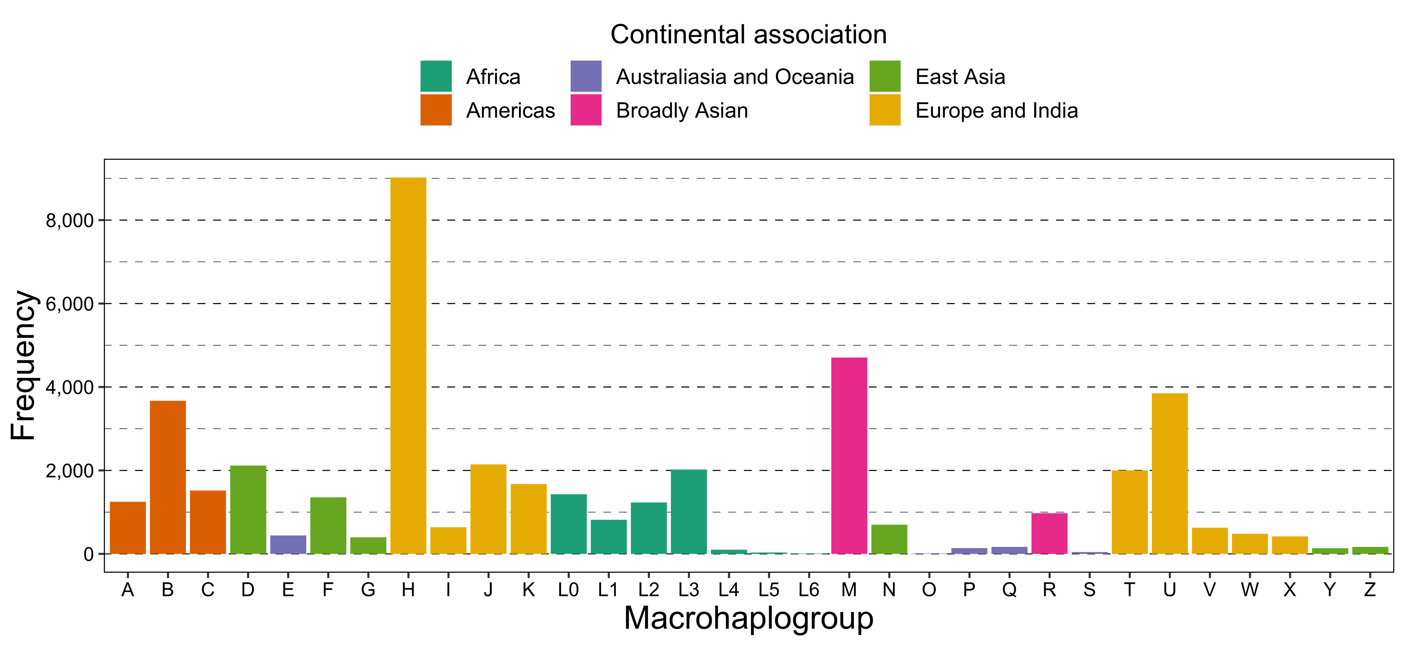
All major macrohaplogroups represented

Slide 18
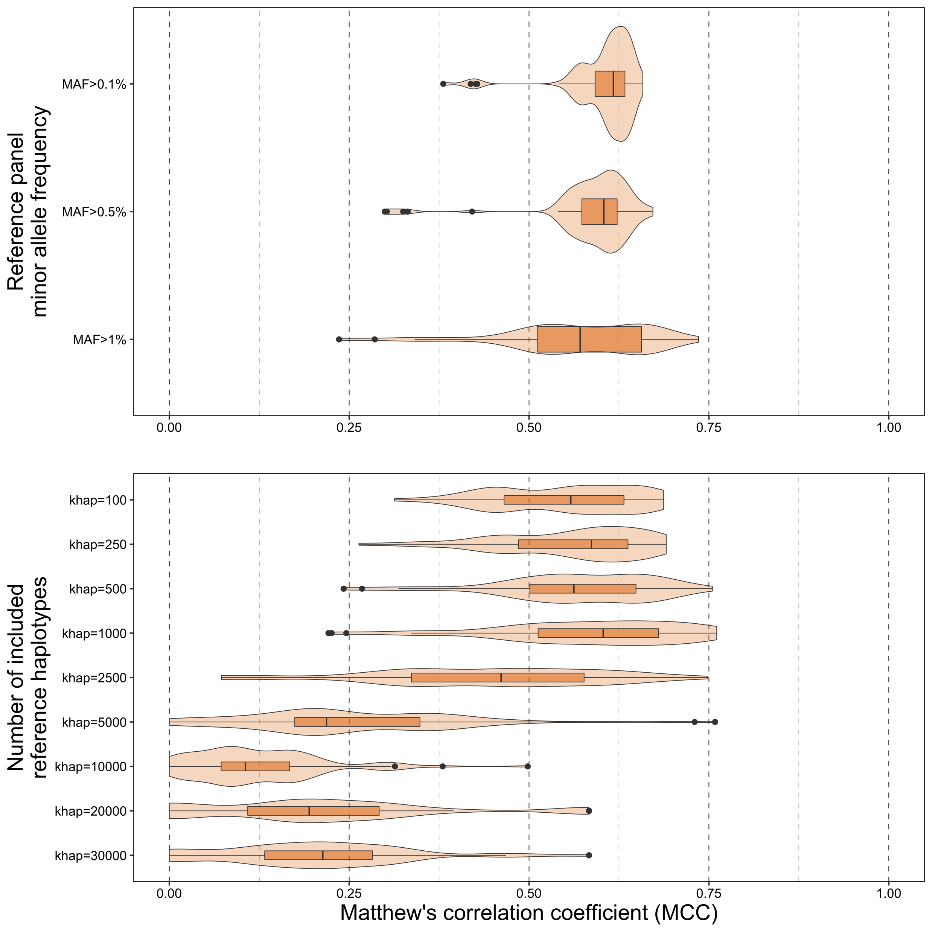
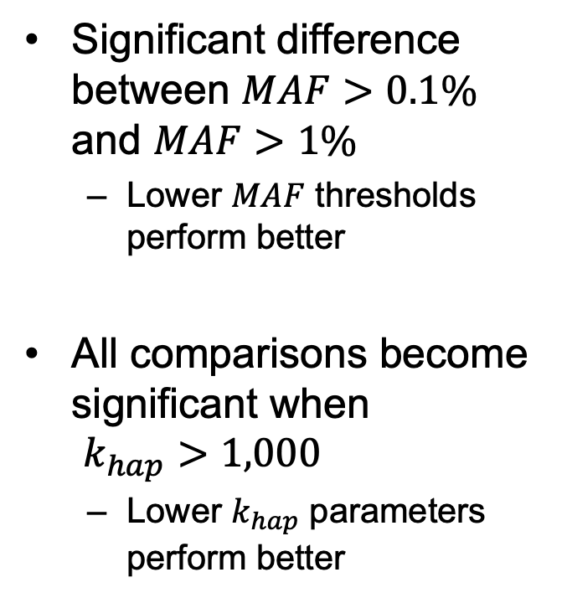
Lower minor allele frequency results in greater genotype imputation accuracy Higher k_{hap} parameter values result in worse genotype imputation accuracy
Significant difference between $MAF>0.1\%$ and $MAF>1\%$
Lower $MAF$ thresholds perform better
All comparisons become significant when $k_{hap}>1,000$
Lower $k_{hap}$ parameters perform better

Slide 19
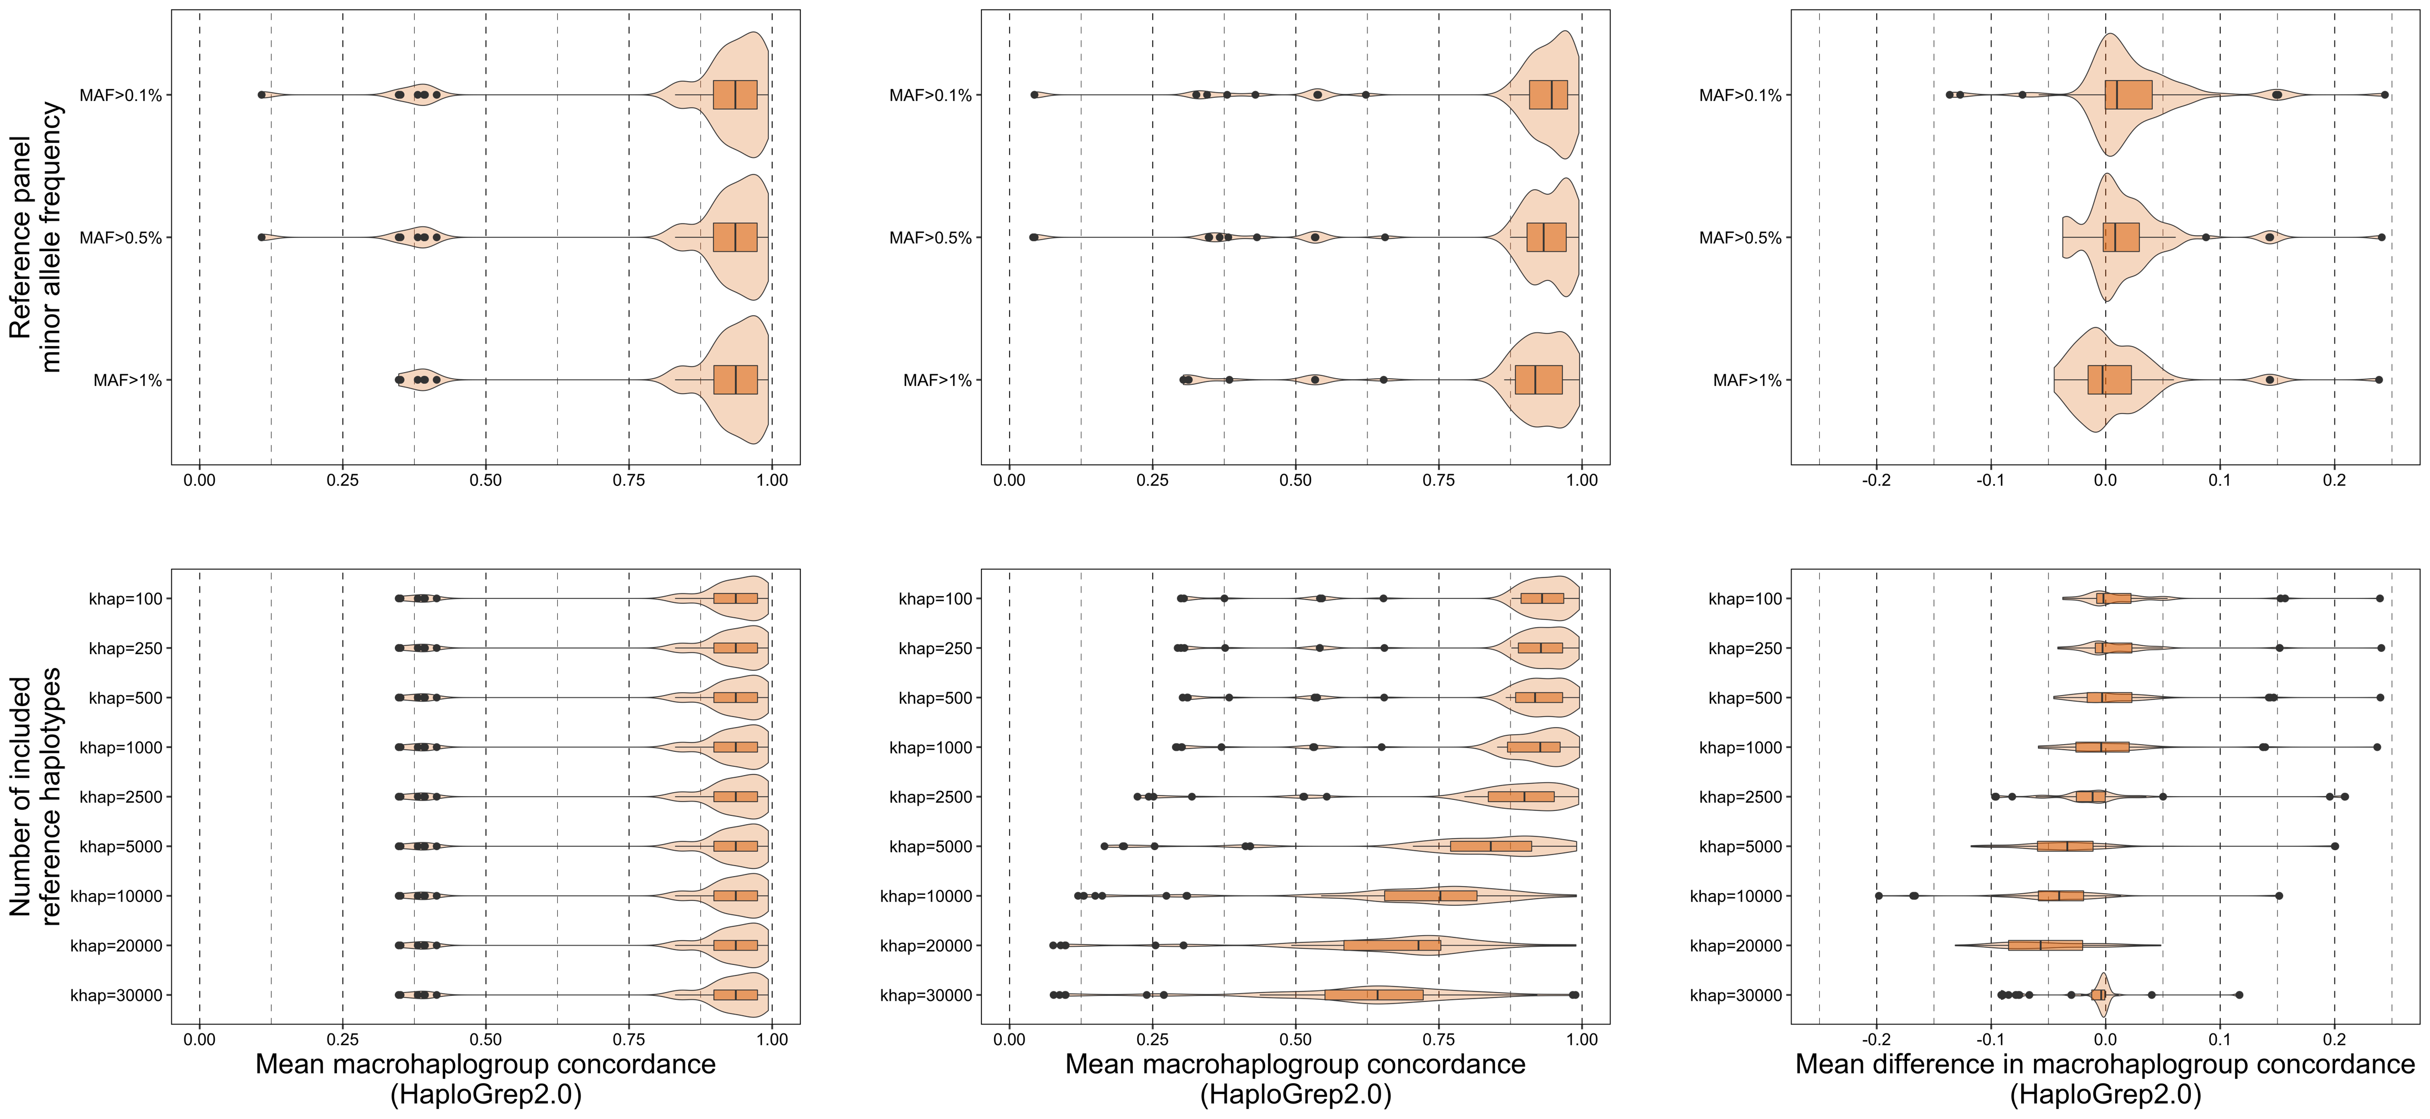
Imputation negligibly improves haplogroup assignment accuracy when assigned using HaploGrep 2.0
Notes:
No significant difference between MAF thresholds for genotyped and imputed macrohaplogroup concordance (when haplogroups are assigned by Hi-MC)
MAF > 0.1% does perform best
Not much to improve on though
Genotyped dataset performs well initially
There is a significant difference when haplogroup performance is examined
MAF > 0.1% is still the best performer – others show a decrease
MAF > 0.1% can capture micro-haplogroups with greater accuracy
Significant difference between k_{hap} values starting at k_{hap}=5,000

Slide 20
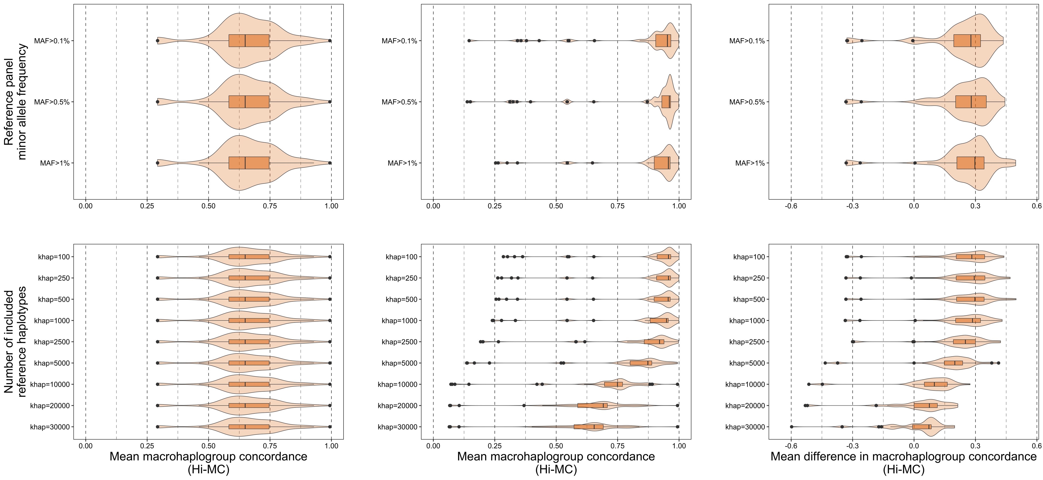
Imputation results in much improved haplogroup assignment when using Hi-MC
Notes:
No significant difference between MAF thresholds for genotyped and imputed macrohaplogroup concordance (when haplogroups are assigned by Hi-MC)
MAF > 1% does perform best
Not much to improve on though
Genotyped dataset performs well initially
There is a significant difference when haplogroup performance is examined
MAF > 0.1% is still the best performer – others show a decrease
MAF > 0.1% can capture micro-haplogroups with greater accuracy
Significant difference between k_{hap} values starting at k_{hap}=5,000

Slide 21
Conclusions
Our reference panel is diverse and high-quality
Geographically and phylogenetically
Our reference panel is useful for imputing missing mtDNA variants
Obvious when genotypes are considered
Not as obvious when haplotypes are considered
Our reference panel has the potential to be a powerful tool to simplify and expedite mtDNA research

Slide 22



Questions?
Thank you! And…
Prof. Simon Easteal
Dr. Hardip Patel
Prof. Lars Jermiin

